Slide 1
从英语翻译成中文(简体) - www.onlinedoctranslator.com
PUSCH基础共享
Cienet BB 南京队

Slide 3
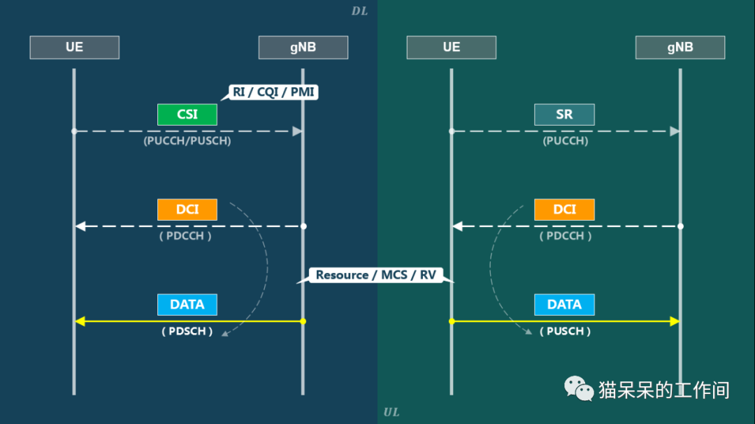

Slide 4
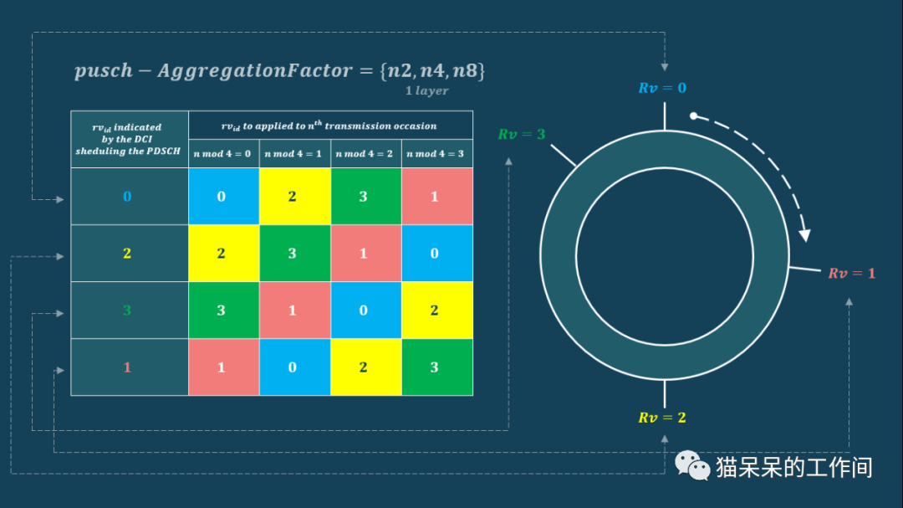

Slide 5
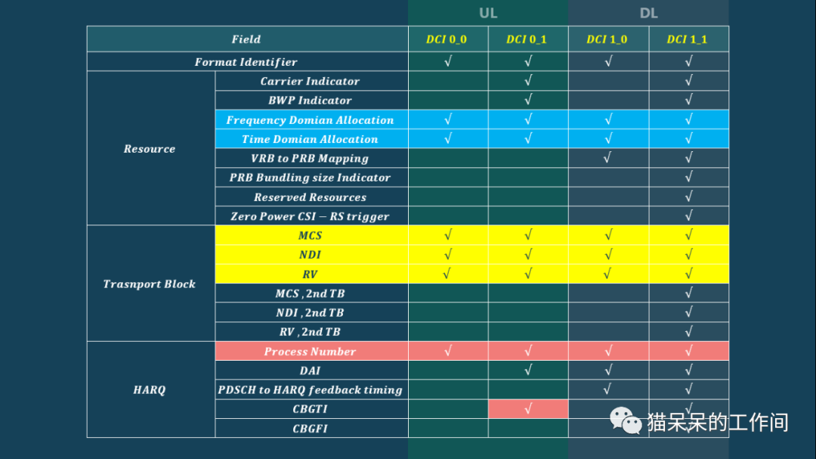

Slide 9
$$x^{\left(3\right)}(i)$$

Slide 11
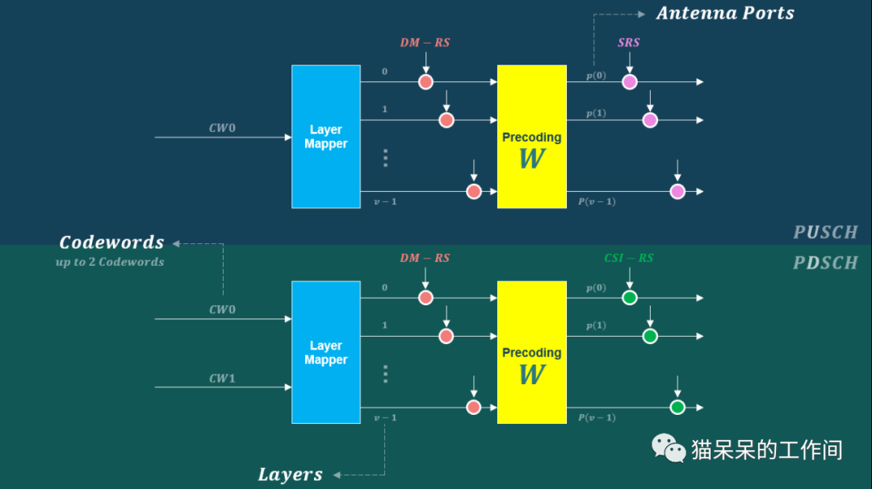

Slide 13
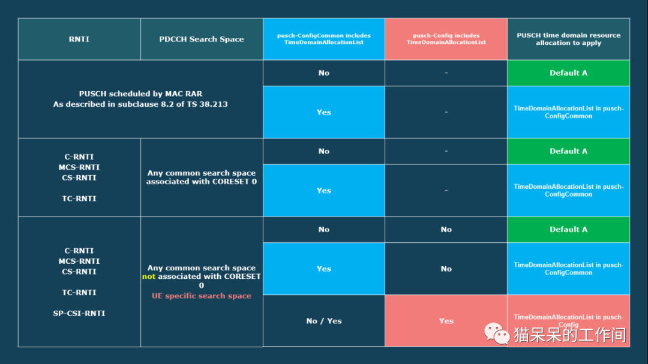

Slide 14
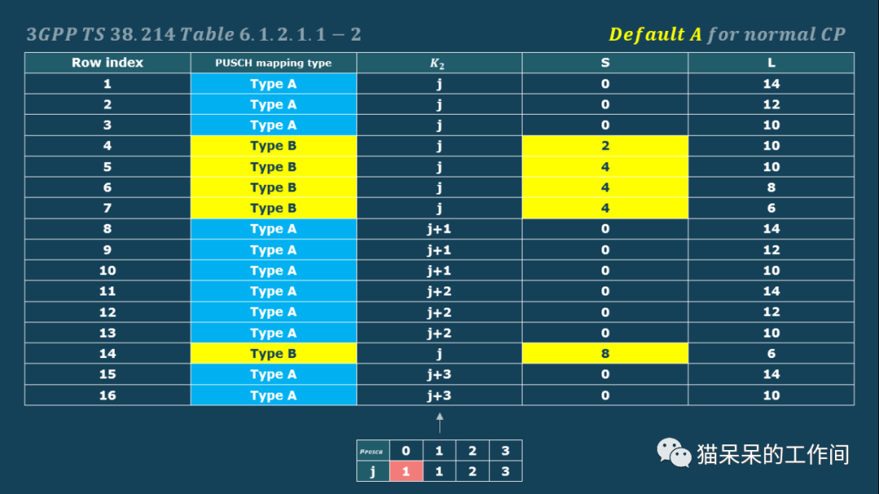

Slide 17
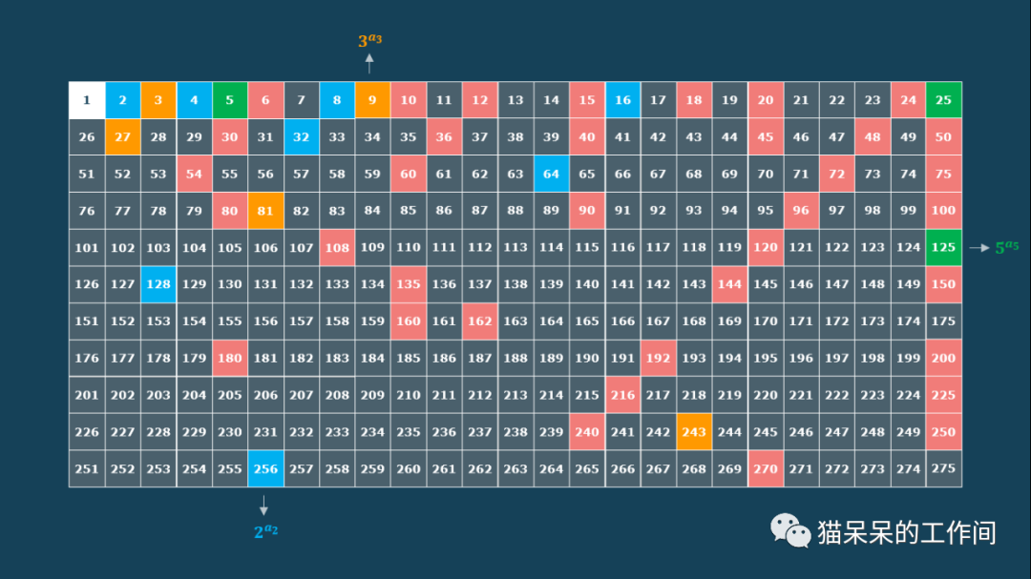

Slide 18
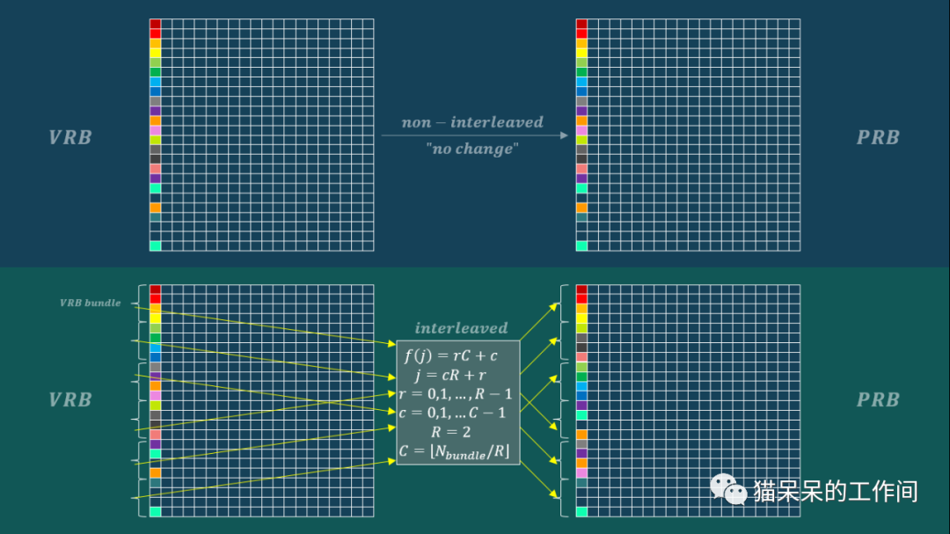

Slide 19
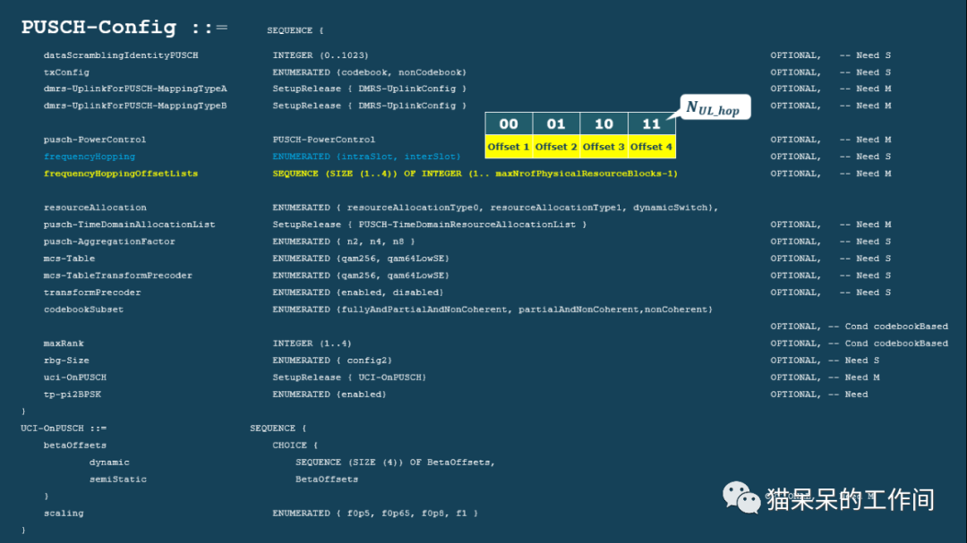

Slide 20
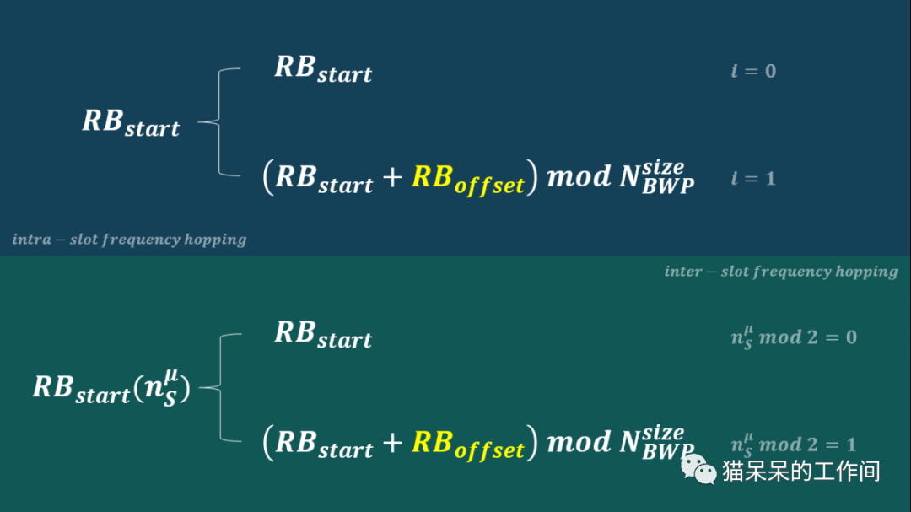

Slide 21
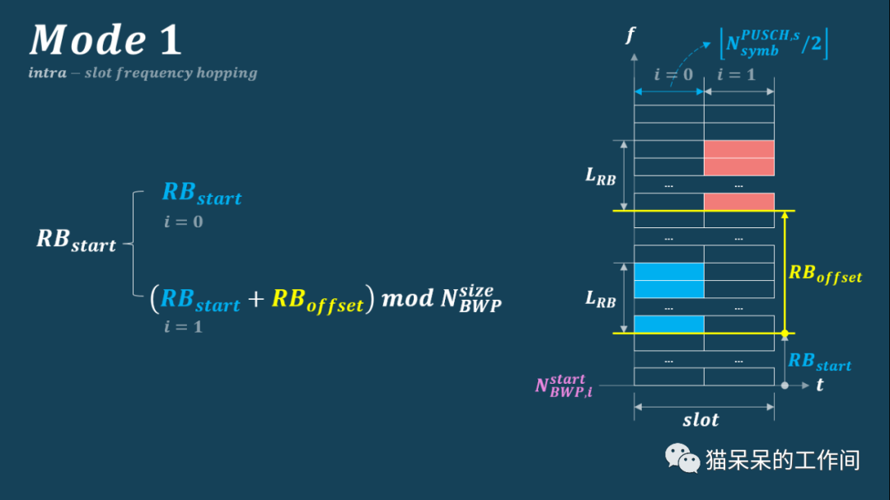

Slide 26
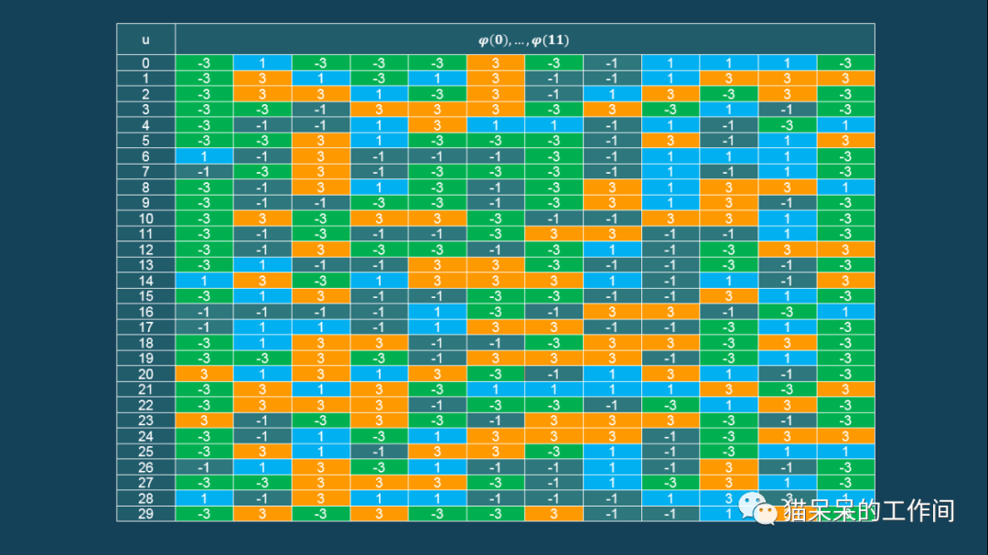

Slide 30
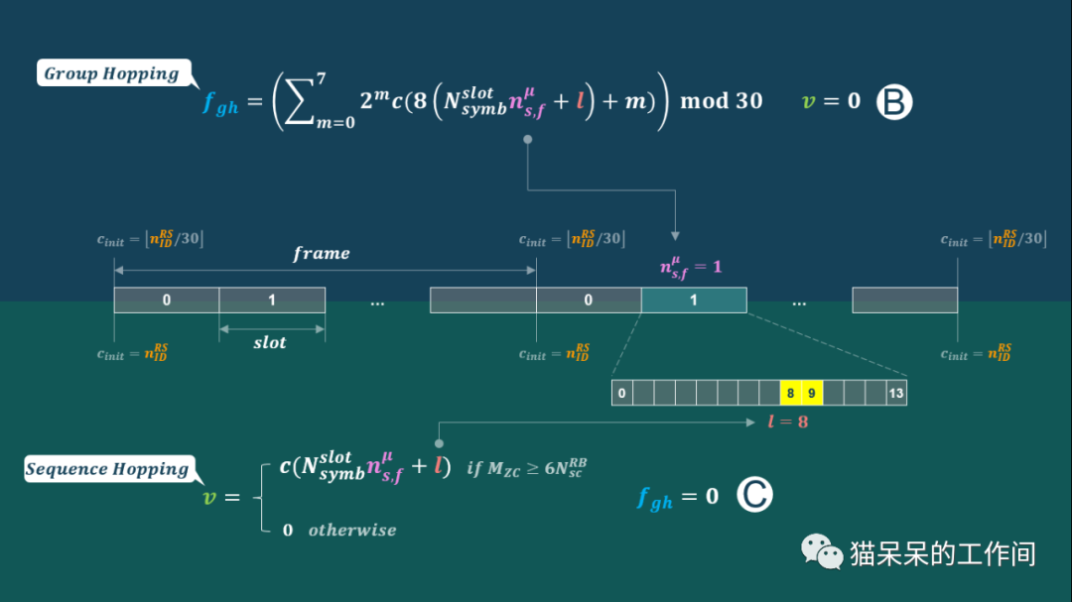

Slide 34
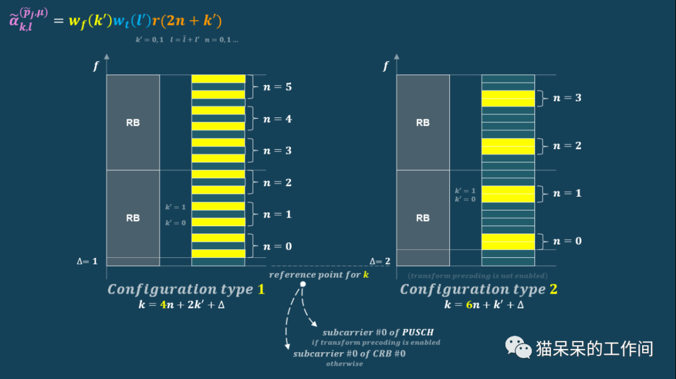

Slide 35
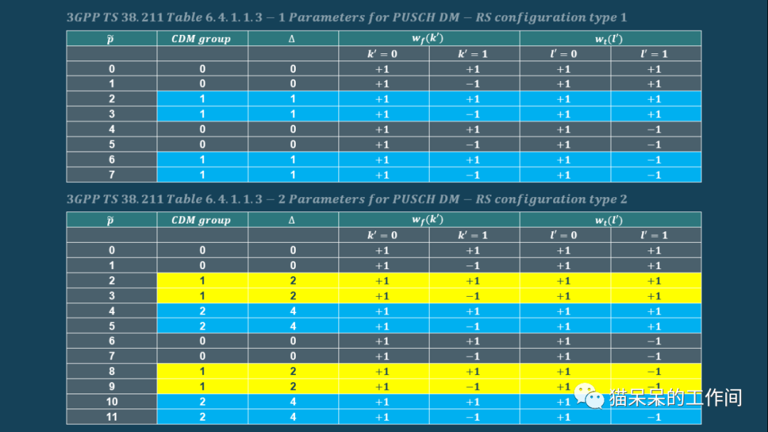

Slide 36
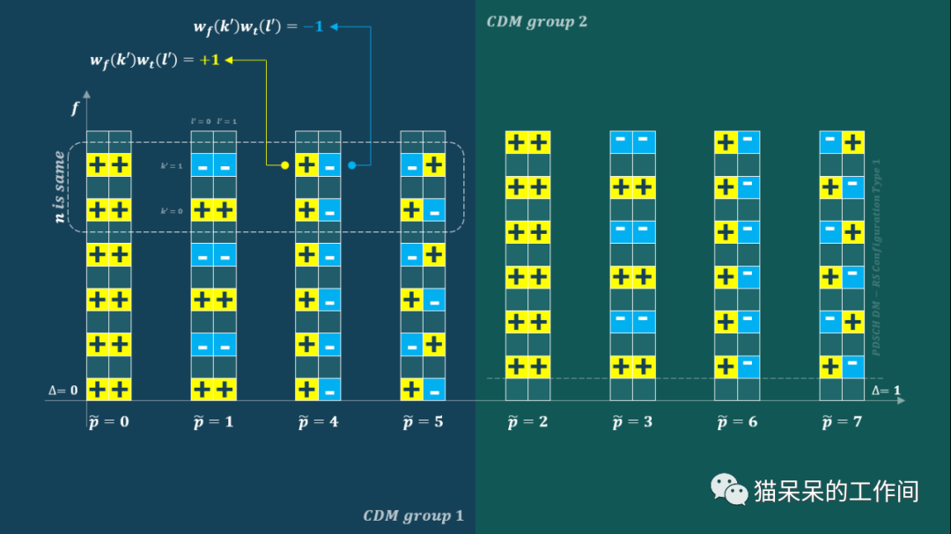

Slide 39
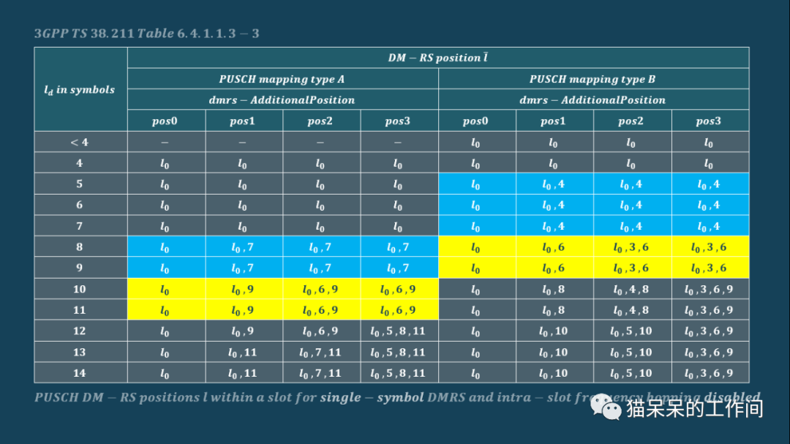
$$PUSCH DMRS positions l within a slot for single−symbol DMRS and intra−slot frequency hopping disabled$$

Slide 40
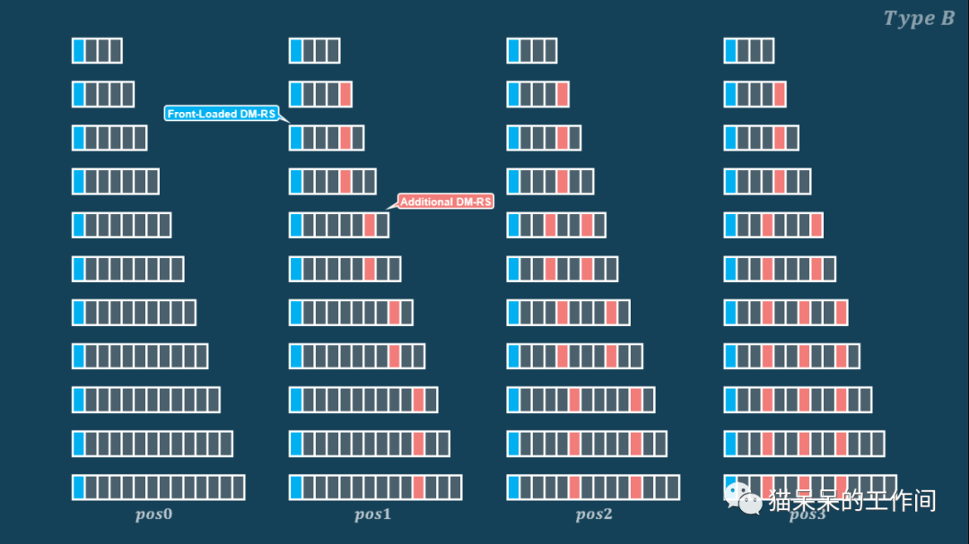
$$pos3$$

Slide 41
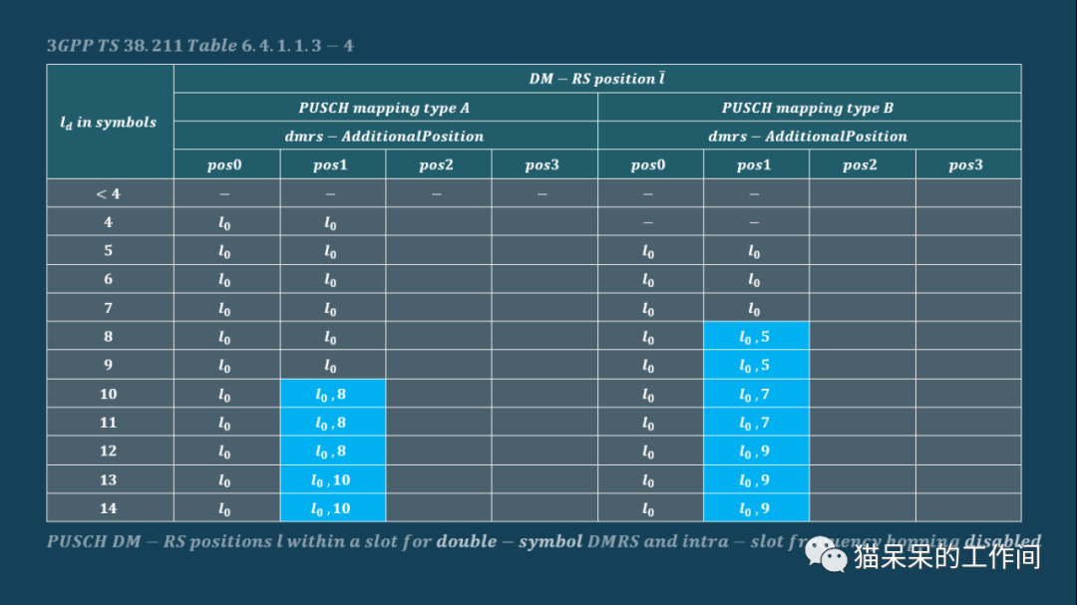
$$PUSCH DMRS positions l within a slot for double−symbol DMRS and intra−slot frequency hopping disabled$$

Slide 43
$$UCI Multiplexing on PUSCH$$
$$number of HARQ−ACK bits$$
$$get from RRC$$
$$REs can be used for UCI$$
$$Q_{ACK}^{′}=min⁡\{\left\lceil \frac{\left(O_{ACK}+L_{ACK}\right)·β_{offset}^{PUSCH}·\sum_{l=0}^{N_{symbol}^{PUSCH}−1}{M_{sc}^{UCI}\left(l\right)}}{\sum_{r=0}^{C_{UL−SCH}−1}{K_{r}}}\right\rceil ,\left\lceil α·\sum_{l=l_{0}}^{N_{symbol}^{PUSCH}−1}{M_{sc}^{UCI}（l）}\right\rceil \}$$
$$number of coded modulation symbols for HARQ−ACK transmission$$
$$the first symbol that does not carry DMRS after the first DMRS symbol$$
$$Q_{CSI−1}^{′}、Q_{CSI−2}^{′} is given by clause 6.3.2.4 of TS 38.212$$

Slide 44
数据
$$Q_{CSI−2}^{′} after CSI part 1$$
DM-RS
CSI-1
CSI-2
混合自动重发请求-ACK
$$Q_{CSI−1}^{′} start from the$$
$$first symbol of PUSCH$$
$$Q_{}^{′}<\frac{RE available}{2}, distributed$$
$$Q_{}^{′}>\frac{RE available}{2}, centralized$$
$$Q_{ACK}^{′} starts from the fisrt symbol after DMRS$$

Slide 45
谢谢
联系方式：tianyang.pang@cienet.com.cn

